Slide 1
Cookbook for Practice 4.1
实践4.1攻略
Cong Li 李聪

Slide 2


Basic Settings 基本设置 (1)
Create a new file ‘multithread.cpp’
创建一个新文件’ multithread.cpp’
Include various header files
引用各种头文件
As always, 10,000,000 steps, records for the last 256 steps
和以前一样，10,000,000步，记录最后256步

Slide 3
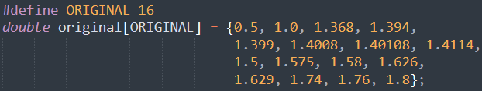

Basic Settings 基本设置 (2)
Again, use the 16 coefficients
依然使用这16个系数
Define the number of series to process, number of threads used, & number of series per threads
定义要处理的序列数，参与处理的线程数，
以及单个线程需要处理的序列数

Slide 4
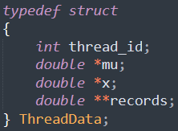
Thread Data 线程数据
Define a struct for transferring critical data to a thread
为将关键数据传给线程定义一个结构
Coefficients, values of series, & records
系数，序列数值，以及记录

Slide 5

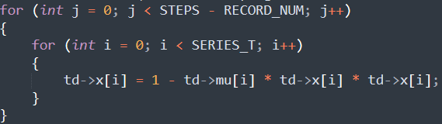
Thread Function 线程函数 (1)
Write a function be run in a thread, starting w/
extracting the data transferred to the thread
编写一个在线程中执行的函数，始于抽取出传入线程的数据
Then the iterative & parallel calculation
然后就是迭代并行计算

Slide 6
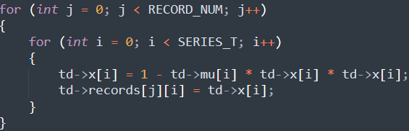

Thread Function 线程函数 (2)
Calculation & recording
计算和记录
Finally return 0 to indicate a success
最后返回0表示成功

Slide 7

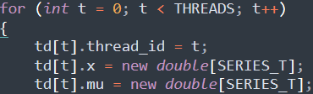
Initializing Thread Data
初始化线程数据 (1)
In the main program, create thread handles & thread data
在主程序中创建线程句柄和线程数据
For each thread, initialize the thread data,
starting w/ space allocation for the ‘x’ & ‘mu’ arrays
为每个线程初始化线程数据，从’x’和’mu’数组空间分配开始

Slide 8
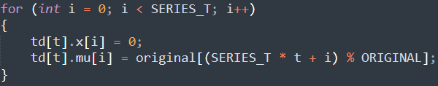
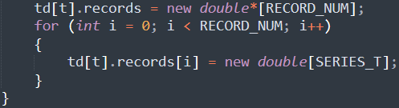
Initializing Thread Data
初始化线程数据 (2)
Now set ‘x’ to be zeros, & replicate the coefficients
现在把’x’清零，并复制系数
Then allocate space for the ‘records’ array
随后为’records’数组分配空间

Slide 9
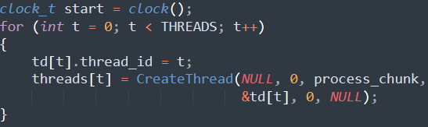
Create & Run the Threads
创建并运行线程
Start timing, & create the threads to
execute the thread functions w/ the thread data
开始计时，创建线程，给定线程数据，开始运行线程函数
Wait for the return of the thread execution &
stop the timer
等待线程执行返回，结束计时

Slide 10
Execution time 执行时间
Calculate & print the execution time
计算并打印执行时间
Then print a message & wait for a click of return
随后打印提示信息，并等待回车按键

Slide 11

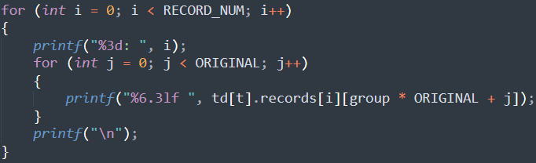
Result Output 结果输出
Pick a random thread & a random replica
随机挑选一个线程和一个副本
Print out the corresponding records
打印对应的记录

Slide 12

Run It 运行之
Close the ‘main’ function w/ a return
从’main’函数返回
Compile & run it 编译并运行之
mingw32-make SRC=multithread.cpp NATIVE=1
run-multithread.exe

Slide 13
The End

